Slide 1
Host Inventory Dashboard Modern Patch & Inventory Automation

Slide 2
Project Overview
Centralized dashboard for Oracle Linux, Debian, Ubuntu hosts
Real-time patch status, host inventory, and automation
Integrates Ansible, PHP/MySQL, and Cognizant branding

Slide 3

Key Features
Dashboard: All hosts, patch status, OS, uptime, environment
Host Details: Upgradable packages, host metadata
Search: Fuzzy search, filters, CSV export
Responsive UI: Dark mode, sidebar, badges, animations

Slide 4
Security
API Key for Ansible Playbook Ingestion: Only trusted playbooks can ingest data
Password Hashing: Secure login with crypt (password hash, password verify)
Session Management: All pages require authentication
Input Sanitization: Prevents SQL injection

Slide 5
visual Overlook
Presenting the screenshot of the dashboard

Slide 6
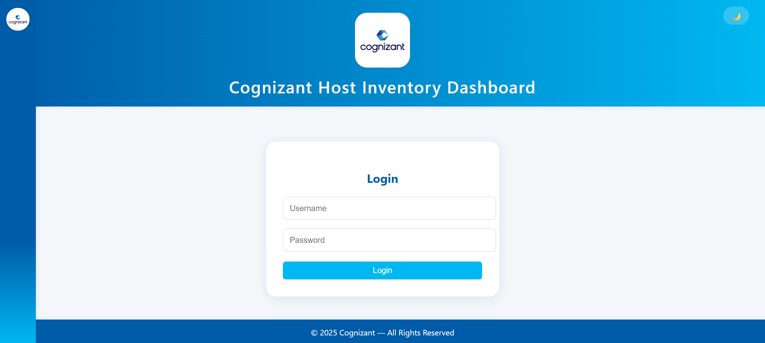
Screenshot

Slide 7
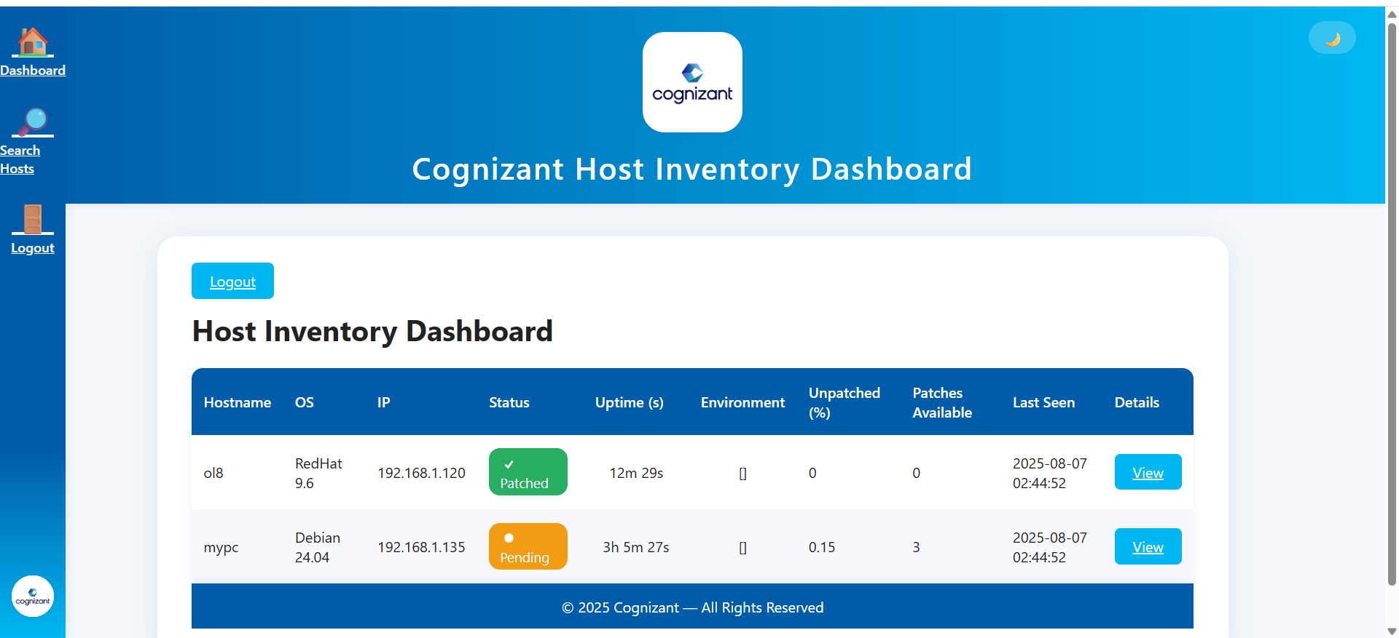
Screenshot

Slide 8
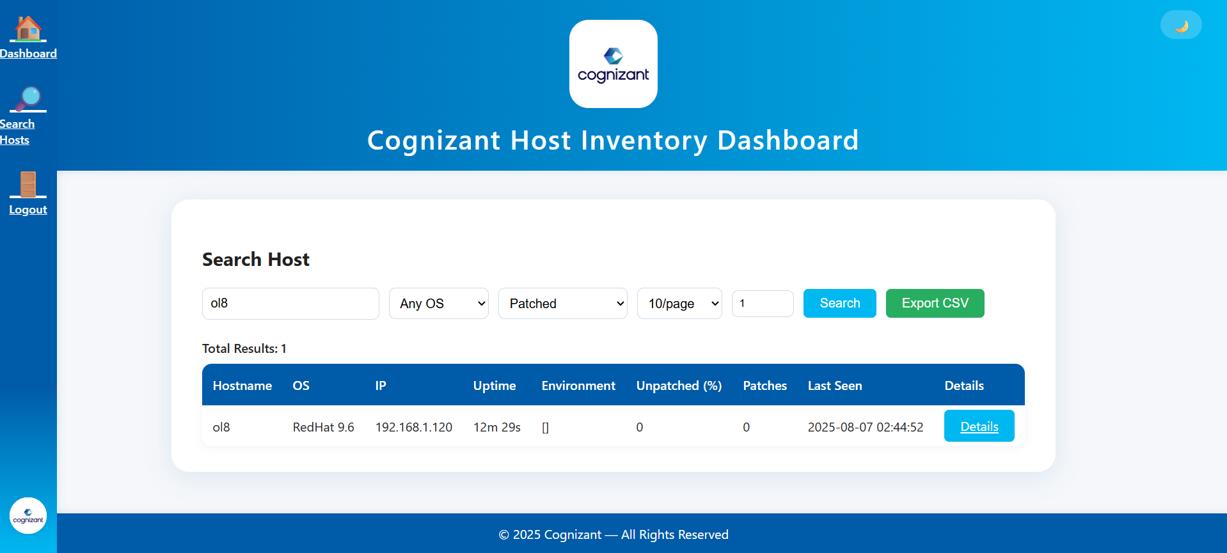
Screenshot

Slide 9
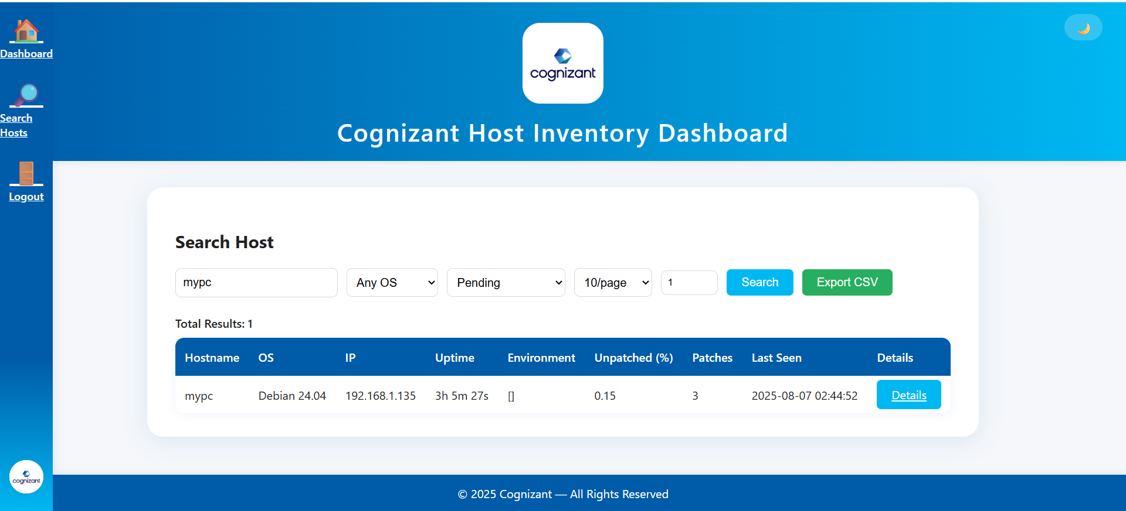
Screenshot

Slide 10
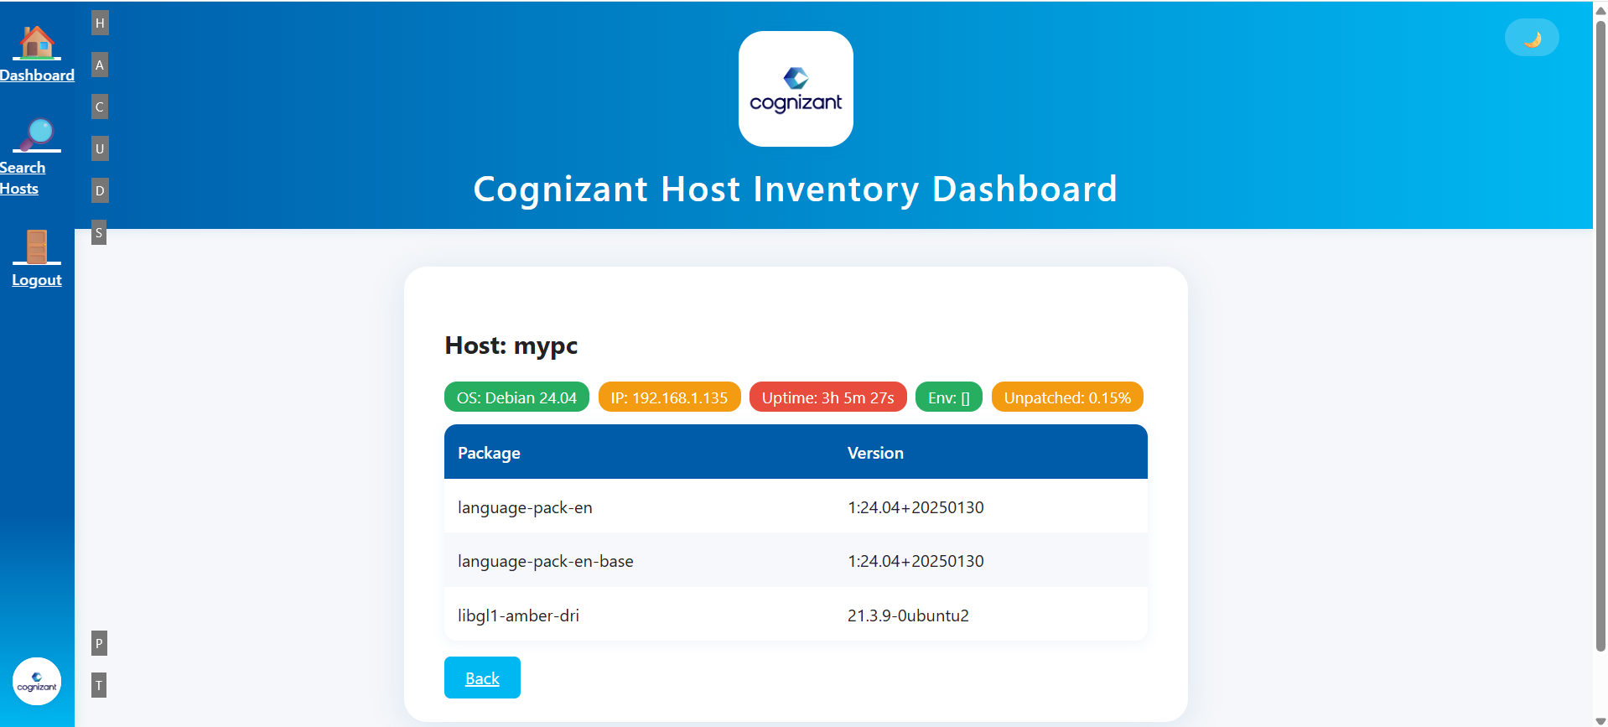
Screenshot

Slide 11
Infrastructure/Business Importance
Reduces manual patching risk
Ensures compliance and uptime
Centralizes multi-OS management
Easy to audit and extend

Slide 12

How It Works
Admin logs in securely
Ansible playbooks gather/report data via API
Dashboard updates in real time

Slide 13
THANK YOU
Munga Lal Shaw
+91 7003965164
Munga.shaw@cogniznat.com​
https://github.com/mungalal/infra-dashboard.git

